Slide 1
Actuarial Science Club
First Meeting

Slide 2
Agenda
Introductions
Brief Summary of Actuarial Science
Social Events
Mentor Program
Dues/Resume Book
Upcoming Meetings
Dues

Slide 3
Introductions
President – Nate Stemberger (stember2@msu.edu)
External Vice President – Karno Sarkar (ksarkar1@msu.edu)
Internal Vice President - Hannah Cregg (cregghan@msu.edu)
Treasurer – Luke Simons (simonslu@msu.edu)
Social Chair - Megan Feldpausch (feldpa77@msu.edu)
Secretary - Brandon Derke (derkebra@msu.edu)

Slide 4
Actuarial Science
Risk Calculation using Mathematics and Statistics
Applications
Insurance (Health, Life, Property)
Consulting (Pension)
Sports
Exam Progression

Slide 5
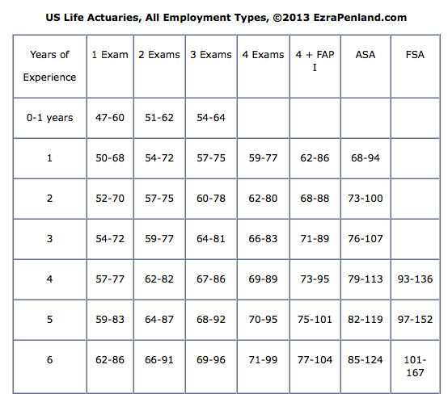
Great Reasons to be an Actuary
1) Salary
2) Work-Life Balance
3) Job Security
4) Consistently ranked as a top job
5) Above average projected job growth

Slide 6
Actuarial Science Exams
P (STT 441, STT 490)
FM (MTH 360, MTH 361, MTH 490)
MLC (STT 455 and STT 456)
MFE (FI 379, MTH 457, MTH 458)
C (STT 459)

Slide 7
Actuarial Class Help at the Wells Hall MLC
Monday
2:50 - 4:00
6:20 – 8:40
Tuesday
2:50 - 4:00
Wednesday
2:50 – 4:00
Sunday
5:10 – 8:40

Slide 8
Social Events
Men or Women’s Soccer Game
Volleyball Game
Ice Skating at Munn
Bar Crawl in the spring semester
Follow us on Twitter!
@MsuActsciClub

Slide 9
Volunteer Events
Ashley Ahlin <ashleyrahlin@gmail.com>
Volunteer Training
6:00 October 7th
White Hills Math Night
6:30 – 8:00 October 13th
Girl Scouts STEM day
9:30 – 12:00

Slide 10
Mentor Program
Build community within the club
Learn more about actuarial science
Build a broader network

Slide 11
Mentor Qualifications
At least one actuarial exam passed
OR
At least one actuarial internship
OR
At least one year as a member of actuarial science club

Slide 12
Mandatory Events
Go to at least one career fair together
Check–in with buddy once a week
Attend the Resume Workshop
Kickoff meeting at 6:30 September 16th

Slide 13
Suggested Events
Networking event
Volunteer event
Social event such as volleyball games
Attend a class with an actuarial focus
Go to the Simon Lecture together
Meet an actuarial professor during office hours. (Or our new director)

Slide 14
Resume Book Program
Following the resume workshop on 9-16 we will be making a book of the club members resumes’.
The resume book will be sent out to each company ahead of their visit so they can set up interviews for full time and internship positions.

Slide 15
Dues
Dues are $20 per year (cash or check)
Notification of club only events and volunteer opportunities
Access to exam resources
Club only programs (mentor, resume workshop, resume book, etc.)
Includes Bar-Crawl T-shirt!!!

Slide 16
Company Visits
Company visits are a chance for students to get a first-hand account of some of the various firms that hire actuaries.
Students are able to network with actuaries in the field, learn about the actuarial profession, gain tips to success within their career path, and find potential internship/full-time opportunities.

Slide 17
What you should expect:
Members should expect to understand what type of work each company does after a company visit.
This ranges from consulting to insurance, P&C to health and life, SOA to CAS, and various other unique qualities of the company.
Members should be able get a better idea of whether they can see themselves working at these various companies.
Also, this is a good way of seeing if this profession is for you.
If companies have not given you a clear enough picture of who they are, what they do, or what the actuarial profession is like, ASK QUESTIONS!!!!!!

Slide 18
What Companies Expect:
Companies take a lot of time and effort to come to MSU and recruit:
They expect a polished student body coming to these meetings with open minds and a desire to learn about them.
Proactive students that will come ready with questions.
Attentive listeners who are engaged in the discussion and looking forward to what they hear.

Slide 19
What you should do:
Come dressed to impress. This means business formal or business casual at the very least. You do not need to bust out the suit and tie every company visit but look like you’re ready to be a big kid with a job.
Bring polished résumés to show companies so that they know MSU students are serious candidates for their internship/full-time positions.
Come in with a positive attitude.

Slide 20
QUESTIONS?

